Slide 1
Damian Betebenner

Slide 2
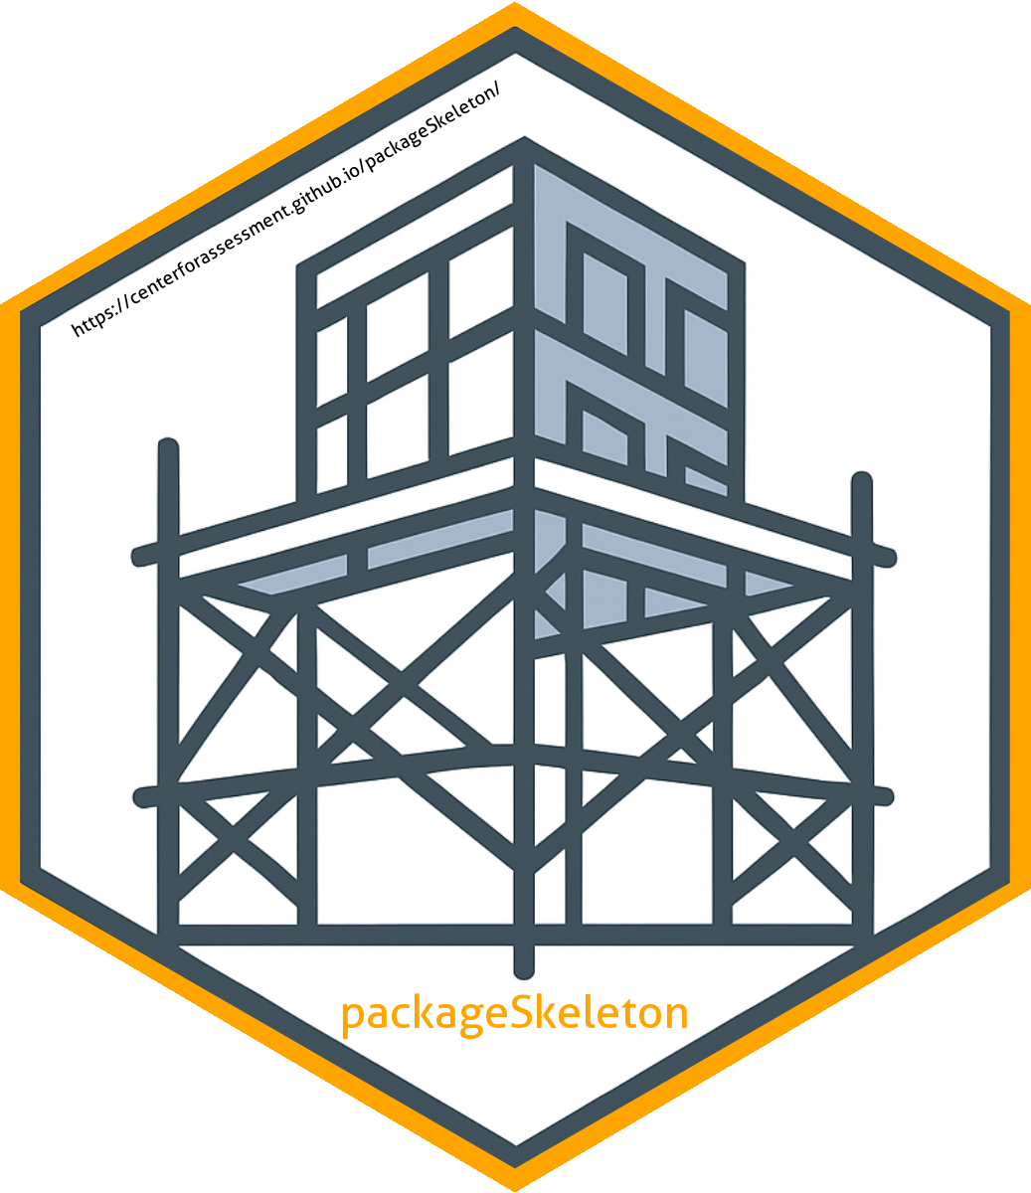
packageSkeleton
A modular data sciencedevelopment framework.

Slide 3
ReproducibleResearch

Slide 4
Reproducible Research
Reproducible research is a cornerstone of modern data science.
The biggest enemy of reproducible research is complexity.
Taming complexity requires a foundation (i.e., a framework) that provides a structure for the development of the analytic capacities providing for an easily maintained integration of the analytic tools, documentation, and content associated with the analytic tools.
Without a solid foundation, analytic tools often become “spaghetti code” that is barely reusable, not reproducible, and not well documented.
The goal of packageSkeleton is to provide a foundation for data science research that is reproducible, reusable, and well documented.

Slide 5
WhypackageSkeleton?

Slide 6
Introduction to packageSkeleton
packageSkeleton is a streamlined GitHub template designed to simplify R package development.
It also integrates with a Quarto-powered website hosted on GitHub, providing users a structured way to develop, document, and distribute their work.

Slide 7
Why packageSkeleton?
Encourages best practices in R package development
Provides a structure that integrates R code and documentation
Simplifies setting up a website for sharing your work
Ideal for both beginners and experienced developers

Slide 8
Key Features
R Package Template: A basic structure that you can easily customize for your package needs.
GitHub Integration: Fork or clone the repository and start developing right away.
Quarto Documentation: Create rich, dynamic content in multiple formats (e.g., HTML, PDF, DOCX, PPTX, etc.) that documents your package and provides a public-facing website.

Slide 9
Customizing packageSkeleton
Rename the Package: Start by modifying the DESCRIPTION file and renaming the package.
Add Your Own Functions: Inside the R/ directory, include your custom R functions.
Generate Documentation: Use roxygen2 to create function documentation and Quarto to build your website.
Deploy the Website: Publish the Quarto website using GitHub Pages.

Slide 10
Requirements
R: The latest version of R (available from CRAN)
Quarto: The Quarto CLI tool for building documents and websites (Install Quarto).
Git: Version control to manage your code and push to GitHub.
GitHub: Host your R package and website.

Slide 11
GitHub Workflow
Fork the Repository: Start by forking the packageSkeleton repo from GitHub.
Clone Locally: Clone the repo to your local machine using Git.
Push Changes: After making your edits, push them to your GitHub repository.
Deploy Website: Use GitHub Pages to host the Quarto-based documentation.

Slide 12
Customizing the Website
Quarto Configuration: Customize the _quarto.yml file to change the website settings such as title, author, and repository URL.
Add Pages: Create .qmd files to add custom documentation, tutorials, and more.
Themes & Layouts: Modify the website’s theme using CSS or choose from Quarto’s built-in themes.

Slide 13
Building Your Package
Add Functions: Use the R/ folder to store your custom R scripts and functions.
Generate Documentation: Write roxygen-style documentation for each function and build it using devtools::document().
Check Your Package: Ensure your package passes all R CMD checks by running devtools::check().

Slide 14
Publishing the Website
Build the Website: Run quarto render to build the static HTML content.
Publish on GitHub Pages: Push your changes to the repository and GitHub Pages will automatically deploy the site.
Preview Locally: Use quarto preview to see live updates of the website as you edit.

Slide 15
Conclusion
packageSkeleton is a powerful starting point for R package development.
Use it to streamline your workflow, create well-documented R code, and publish it with a professional Quarto-powered website.
Leverage GitHub for collaboration, version control, and public distribution of your work.

Slide 16
FutureDirections

Slide 17
Future Directions
NextJS Integration: Integrate packageSkeleton into NextJS framework to facilitate the development of a more robust and scalable data science development framework.
Web API Development: Expose analytics results as web APIs to be used by users as well as other applications.
MCP Integration: Utilize Model Context Protocol (MCP) to expose package tools and resources for integration with popular AI services.

Slide 18
Resources

Slide 19
Resources
Quarto Documentation
R Package Development
GitHub Pages

Slide 20
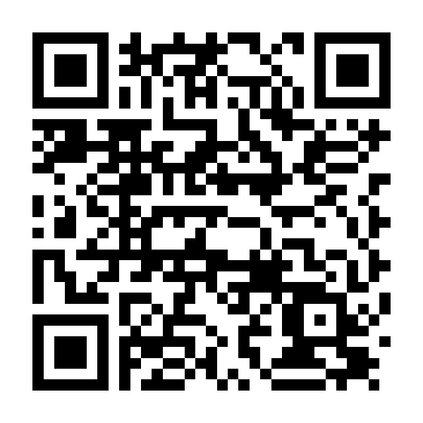
For the Presentation

